Slide 1

Customer Churn Prediction Using Python and Data Visualization
A project proposal by Utkarsh (AF04991819), Batch ANP-D2868, Course DAVIS-1.

Slide 2

Introduction to Customer Churn
Customer churn occurs when clients stop using a company's services. Retaining existing customers is more cost-effective than acquiring new ones, making churn analysis vital for industries like telecom, banking, and subscription services.

Slide 3
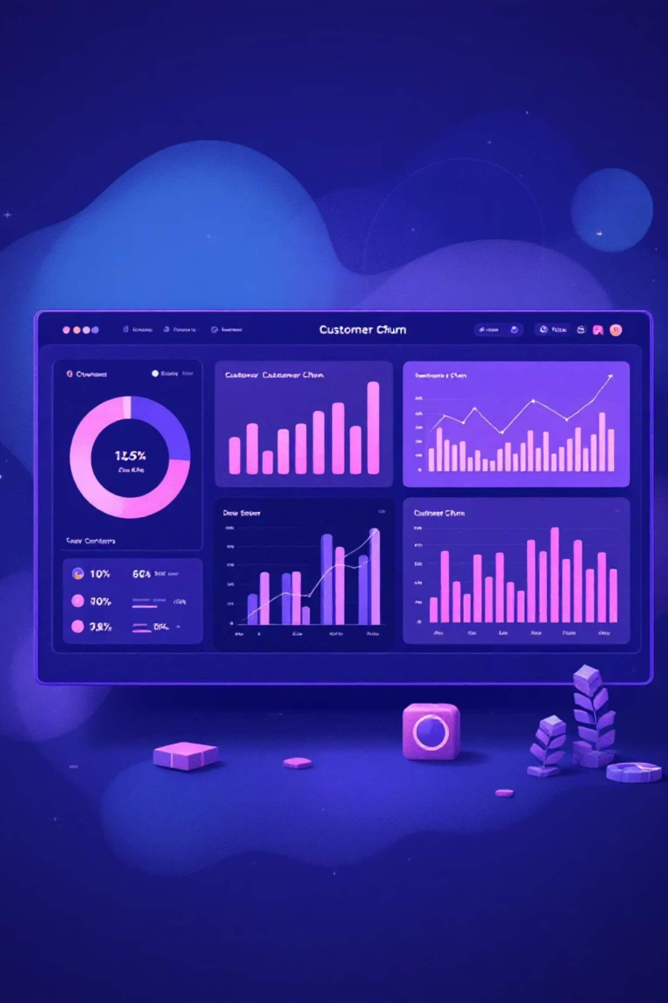
Project Overview: Churn Analysis & Visualization
This project, "Customer Churn Analysis and Visualization Using Python," explores customer data to identify trends and visualize factors contributing to churn. It uses Python libraries like Pandas, NumPy, Matplotlib, and Seaborn for data cleaning, preprocessing, and detailed visual exploration.

Slide 4
Key Objectives
1
2
3
Analyze Data
Identify Factors
Perform EDA
Understand customer retention and churn patterns.
Pinpoint influences like contract type, service usage, and demographics.
Detailed exploratory data analysis using Python libraries.
4
5
Generate Visuals
Support Decisions
Create clear charts and maps for relationships.
Provide actionable insights for retention strategies.

Slide 5

Project Category: Data Analysis & Visualization
This project focuses on Exploratory Data Analysis (EDA) and Data Visualization using Python. It involves collecting, cleaning, processing, analyzing, and visually interpreting customer churn data to extract meaningful business insights, without machine learning or predictive modeling.

Slide 6

Analysis: Problem & Requirements
Problem Definition
Functional Requirements
Identify characteristics and attributes that differentiate churned from retained customers, and how demographics, service, and billing impact retention. Focus on insight generation through visualization.
Import & preprocess data.
Perform EDA & visualize attributes.
Generate correlation maps.
Highlight influential churn factors.
Produce detailed documentation.

Slide 7





System Modules & Data Flow
Data Collection & Loading
Load CSV, inspect structure, identify missing values.
Data Cleaning & Preparation
Handle missing values, convert types, filter records.
Exploratory Data Analysis
Descriptive statistics, distribution analysis, churn comparison.
Data Visualization
Bar charts, heatmaps, pie charts, pairwise comparisons.
Insight Extraction & Reporting
Highlight findings, identify patterns, recommend strategies.

Slide 8
Platform Requirements
Hardware
Software
Operating System: Windows / Linux / macOS
Processor
Intel Core i5+
Python (3.7+)
RAM
8 GB or more
Jupyter Notebook / VS Code
Storage
2 GB free space
Libraries: Pandas, NumPy, Matplotlib, Seaborn
System Type
64-bit preferred

Slide 9


Future Scope & Expansion
Machine Learning Models
Predict customer churn.
Interactive Dashboard
Real-time, user-friendly analysis.
Automate Data Pipeline
Automatic cleaning, processing, visualization.
Customer Segmentation
Tailor retention strategies.

Slide 10

Bibliography
Wes McKinney, Python for Data Analysis, O'Reilly Media, 2018.
Jake VanderPlas, Python Data Science Handbook, O'Reilly Media, 2016.
Pandas Documentation – https://pandas.pydata.org
NumPy Documentation – https://numpy.org
Matplotlib Documentation – https://matplotlib.org
Seaborn Documentation – https://seaborn.pydata.org
IBM Sample Data: Telco Customer Churn Dataset.
TutorialsPoint – Python Data Science and Visualization Resources.
GeeksforGeeks – Python Data Analysis & Visualization Articles.
Kaggle – Customer Churn Datasets and Data Exploration Notebooks.

